Slide 1
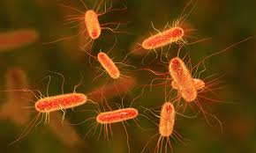
Bacteria
Presented by:
Dr. Ankit Kumar Singh
Assistant Professor
Department of Botany
Marwari College
Lalit Narayan Mithila University
Darbhanga
ankitbhu30@gmail.com

Slide 2
Bacteria?
Bacteria are microscopic and least differentiated living organisms, believed to be amongst the first primitive organisms on the earth.
Bacteria were first observed in rainy water and later in teeth scum by Leeuwenhoek and called them “Animalcule”.
Robert Koch first of all cultured bacteria
The branch which deals with study of bacteria is known as bacteriology.
Anton Van Leeuwenhoek is father of bacteriology.
Two major types of cell-division i.e., mitosis and meiosis are absent in bacteria but in Bacillus megatherium mitosis is present

Slide 3
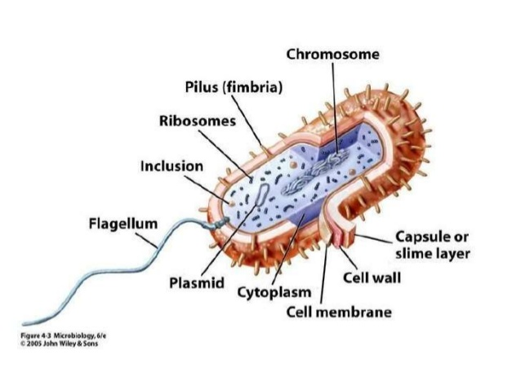
Structure of Bacterial cell
Str

Slide 4
Bacterial cell structure organized into three categories :
External structures (appendages & coverings): flagella, fimbriae, sex pilus and glycocalyx
Cell envelope: Cell wall, cell membrane
Internal Structures: Cytoplasm, nucleoid, bacterial chromosome, plasmid, ribosome, and storage granules
CELL Wall
Outer covering of most cells that protects the bacterial cell and gives it shape (spherical, rod and spiral)
Composed of peptidoglycan (polysaccharides + protein)
On the basis of amount and location of peptidoglycan in the cell wall bacteria are either gram positive or gram negative

Slide 5
The backbone of the peptidoglycan molecule is composed of two derivatives of glucose: N-acetylglucosamine (NAG) and N-acetlymuramic acid (NAM).
The NAG and NAM strands are connected by inter peptide bridges.
Gram positve bacteria possess thick cell wall containing many layers of peptidoglycan and teichoic acids.
In Gram positive cells, peptidoglycan is the outermost structure and makes up as much as 90% of the thick compact cell wall.
Gram negative bacteria have relatively thin cell wall consisting of few layers of peptidoglycan surrounded by a second lipid membrane containing lipopolysaccharides and lipoproteins
Peptidoglycan makes up only 5 – 20% of the cell wall and is not the outermost layer, but lies between the plasma membrane and an outer membrane.

Slide 6
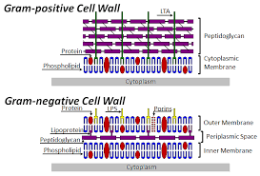

Slide 7
Plasma Membrane
Phospholipid bilayer surrounding the cytoplasm and regulates the flow of substances in and out of the cell.
Consists of both lipids and proteins.
Protects the cell from its surroundings.
Selectively permeable to ions and organic molecules
and controls the movement of substances in and out.
Gram Staining
The technique of staining of bacteria was given by a Dutch microbiologist Christian Gram
Gram-positive bacteria are those that are stained dark blue or violet by Gram staining.
Gram-negative bacteria cannot retain the crystal violet stain, instead take up the counter stain and appeared or pink
The walls of gram-positive bacteria have more peptidoglycans than do gram-negative bacteria. Thus, gram-positive bacteria retain the original violet dye and cannot be counterstained

Slide 8
Cytoplasm
Portion of the cell that lies within the Plasma membrane
substances within the plasma membrane, excluding the genetic material.
Contains cell structures - ribosome, chromosome, and plasmids , as well as the components necessary for bacterial metabolism
Constituents of Cytoplasm
Proteins including enzymes
Vitamins and Ions
Nucleic acids and their precursors
Amino acids and their precursors

Slide 9
Sugars, carbohydrates and their derivatives
Fatty acids and their derivatives
Nucleoid
Unlike the eukaryotic (true) cells, bacteria do not have a membrane enclosed nucleus.
The nucleoid is a region of cytoplasm where the chromosomal DNA is located.
It is not a membrane bound nucleus, but simply an area of the cytoplasm where the strands of DNA are found.
Ribosome
Ribosome is protein synthesis machinery
Bacteria have70S ribosome, It consist of two subunits 30S and 50S
Smaller than the ribosome in eukaryotic cells-but have a similar function
Streptomycin binds 70S ribosome and stops protein synthesis but it can not bind 80S ribosome of eukaryotes

Slide 10
Bacterial Chromosome
Unlike the DNA in eukaryotic cells, which resides in the nucleus, DNA in bacterial cells is not sequestered in a membrane-bound organelle but appears as a long coil distributed through the cytoplasm.
In many bacteria the DNA is present as a single, circular chromosome and in some cases the DNA is linear rather than circular.
Bacterial Plasmid
Small extra-chromosomal DNA
Contain genes for antibiotic resistance or virulence.
Structure Similar to most bacterial chromosomes, but considerably smaller.
Plasmids are covalently closed circular DNA
In a few species linear plasmids have been found.
Number of plasmids: 1-700 copies of plasmid in a cell.

Slide 11
Inclusion bodies - Granules
Granules: Densely compacted substances without a membrane covering.
Nutrients and reserves may be stored in the cytoplasm in the form of glycogen, lipids, polyphosphate, or in some cases, sulfur or nitrogen for later use.
Each granule contains specific substances, such as glycogen (glucose polymer) and polyphosphate (phosphate polymer, supplies energy to metabolic processes).
External structures
Flagella
Made up of protein subunits called flagellin.
Each flagellum is attached to cell membrane with the help of proteins other than flagellin.
The basal region has a hook like structure and a complex basal body. The basal body consists of a central rod or shaft surrounded by a set of rings.

Slide 12
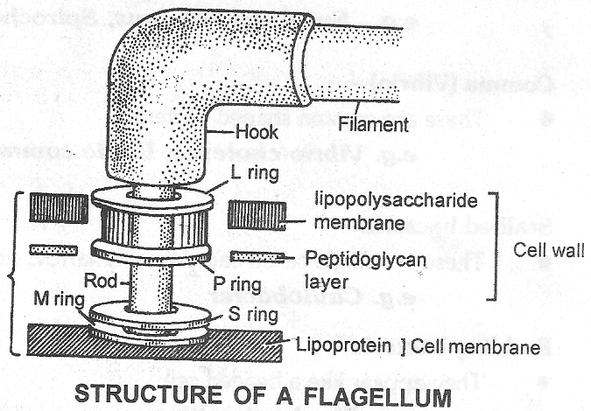
A flagellum of bacteria is made up of three parts.
(1) Basal body (2) Hook (3) Filament
Basal body –
It is the basal part of flagellum and rod shaped in structure.
It lies with in the cell wall and cell membrane
This proteinaceous rod shaped structure is surrounded by two pairs of rings
(i) Outer pair (ii) Inner pair

Slide 13
Outer pair of ring lies with in the cell wall. One ring of this pair is called L and the another called P.
Inner pair of ring lies with in the cell membrane. One ring of this pair is called S and the another is M.
In Gram (+) bacteria only one pair of rings (inner pair) is found
Hook
In connects the basal body to filament
It is the middle part of flagellum. Some parts of the hook lies in cell wall
Filament -
It is cylindrical hollow structure made up of protein monomers.
Each monomers is made up of flagellin protein. Flagellin is a contractile protein like the tubulin of eukaryote

Slide 14
Pili -
Bacterial cell wall is covered by numerous hair like structures called pili. Pili are smaller than the flagella.
They are of two types (A) Longer pili, (B) Shorter pili
Longer pili is also known as ‘F’ pili or ‘sex’ pili. Longer pili occurs in only donar (F⁺ or male) bacteria and help in conjugation. These are absent in recipient bacteria or female
Classification and Economic importance of Bacteria will be presented in next slide

Slide 15
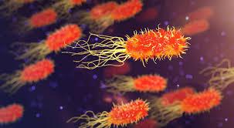
Thank You !!

